Slide 1

COVID-19 & Kidney Transplantation
Shiva Samavat. MD
Labbafinejad Medical Center
30.04.2020

Slide 2

Of about 2500 transplant patients under follow up: 19 were admitted
The mean age of patients was 47.6 ± 12.4 years, with the youngest 29 and the oldest 66 years old.
13 (68.4%) of the cohort were male.

Slide 3
None of our patients with COVID-19 were diagnosed in the first 2 years after transplantation.
Only 3 allograft recipients had been treated for chronic active antibody mediated rejection during the 12-month period prior to admission.

Slide 4
The most common clinical manifestation at the onset of illness was fever (73.7%), followed by dry cough and dyspnea (68.4% and 52.6, respectively(
89.5% of patients were hypoxemic at presentation.

Slide 5
Elevated CRP :89.5%
lymphopenia: 84.2%
Eosinopenia: 78.9%
Thrombocytopenia: 57.9%

Slide 6
Upon admission, 73.7% of patients had AKI.
Ferritin > 300 ng/ml: 83.3%
Elevated LDH level: 58%
Hypoalbuminemia: 52.9%

Slide 7
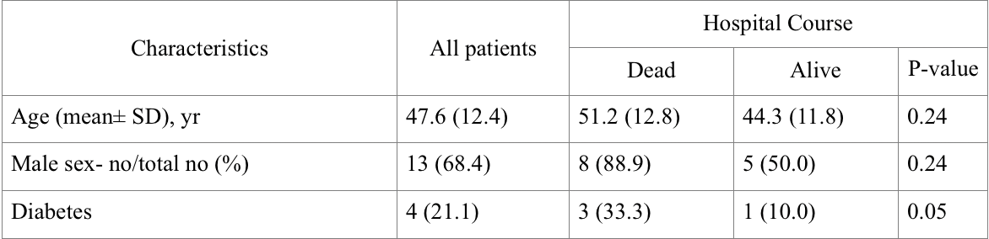
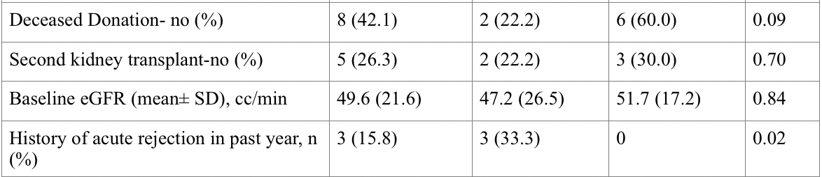

Slide 8
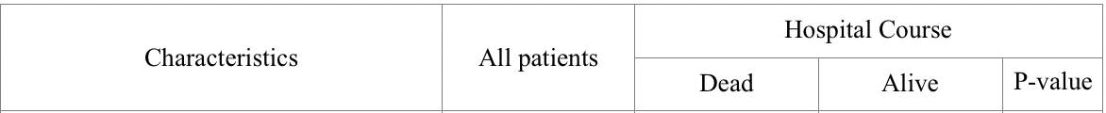
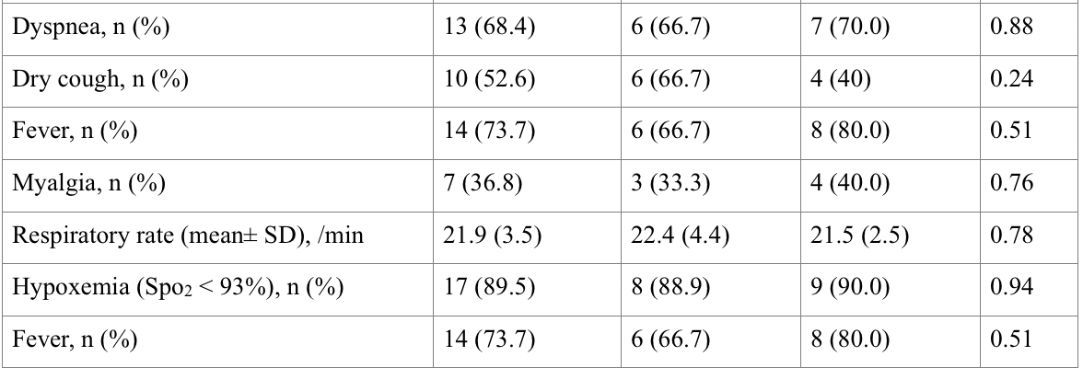

Slide 9
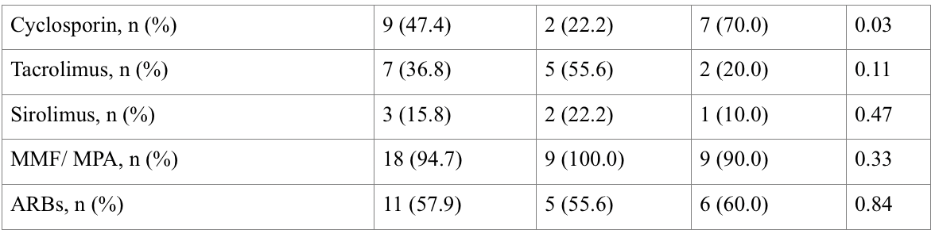

Slide 10
Cyclosporin A has been shown to have an inhibitory effect on proliferation of corona viruses and hepatitis C virus in vitro, while this is not the case for tacrolimus.
Cyclosporin A is thought to inhibit the replication of a diverse array of coronaviruses through its impact on cyclophilin A and B.

Slide 11
Switch therapies from tacrolimus to cyclosporine (with its known in vitro antiviral effect) are potential avenues for future exploration.
Inhibition of FK506 and immunophilin pathway by non-toxic concentrations of Tacrolimus, inhibits growth of coronaviruses such as SARS-COV.

Slide 12
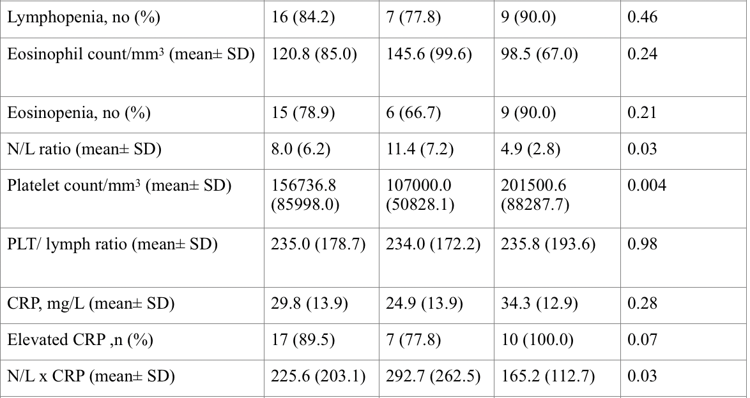

Slide 13
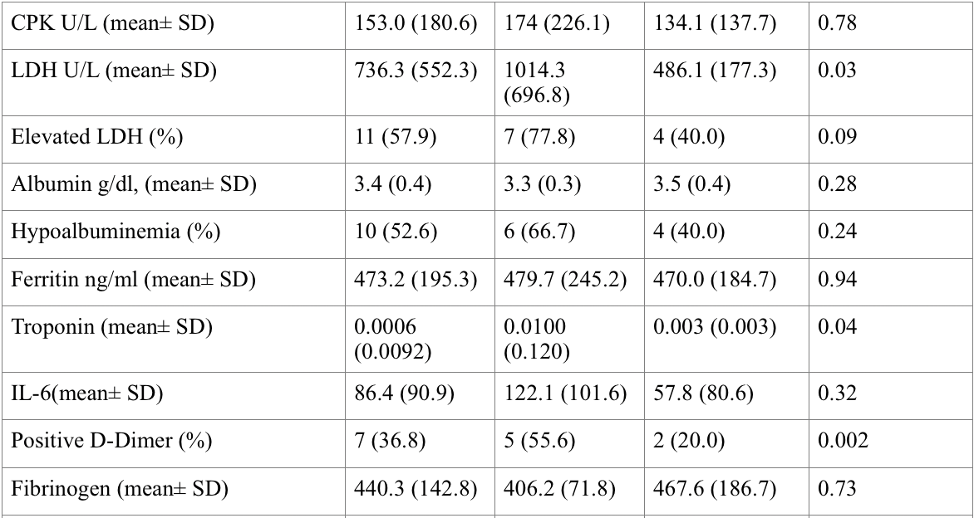

Slide 14
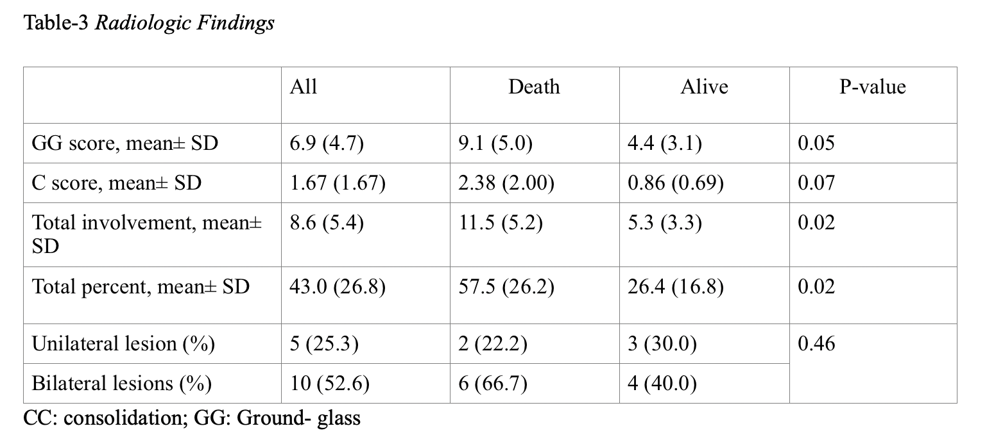

Slide 15
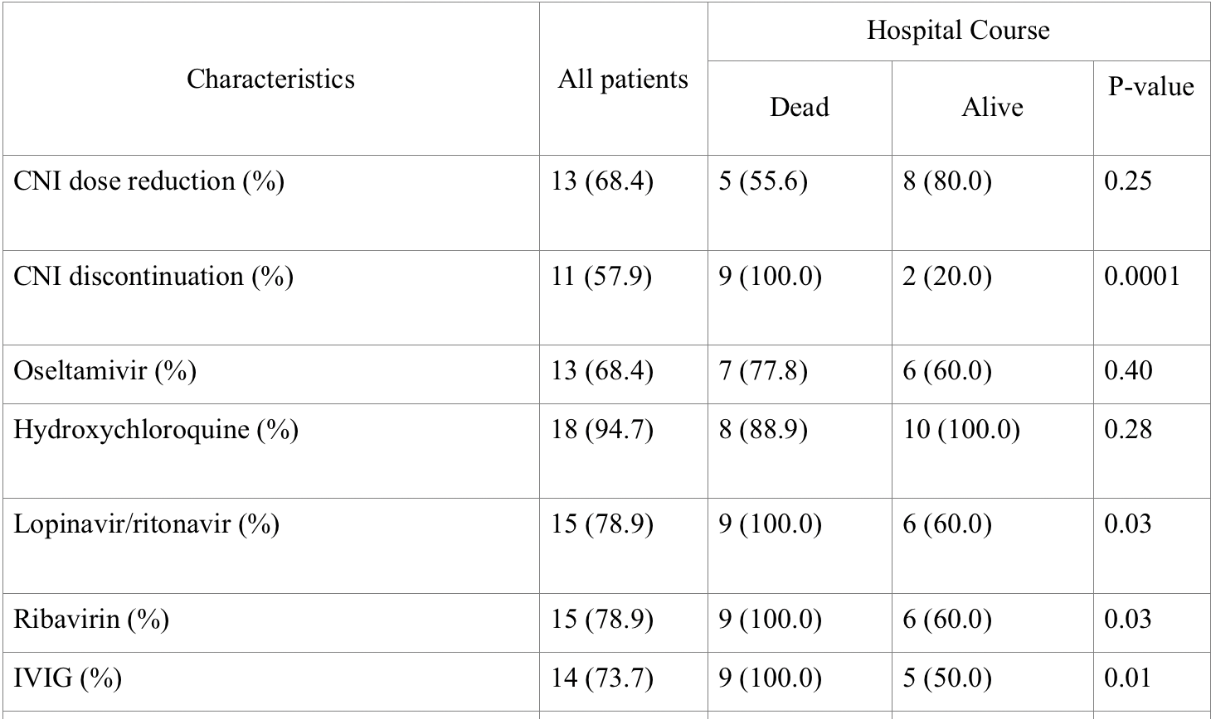

Slide 16
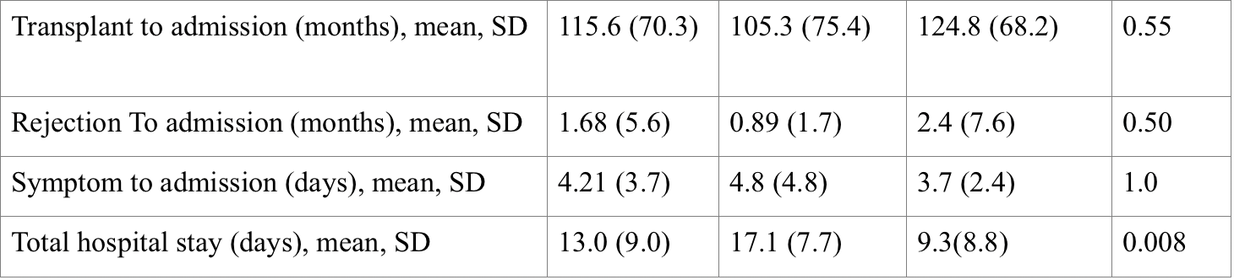

Slide 17
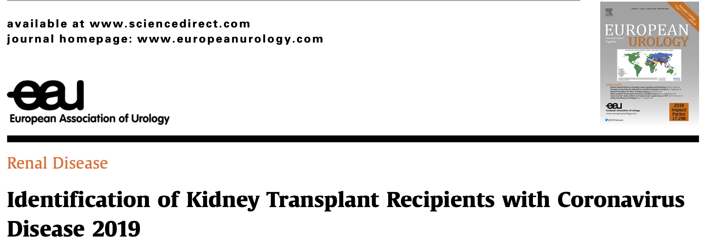
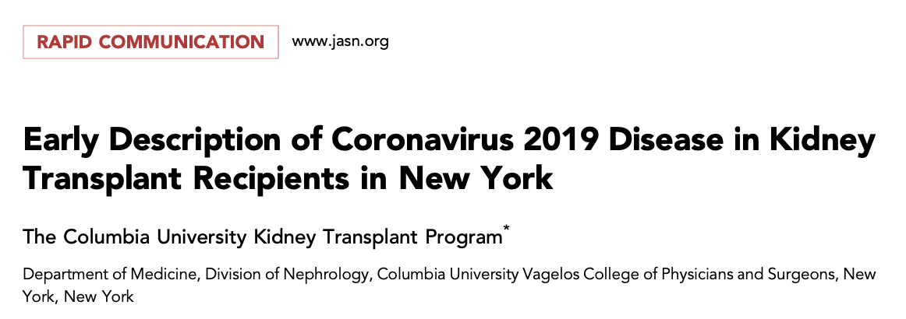
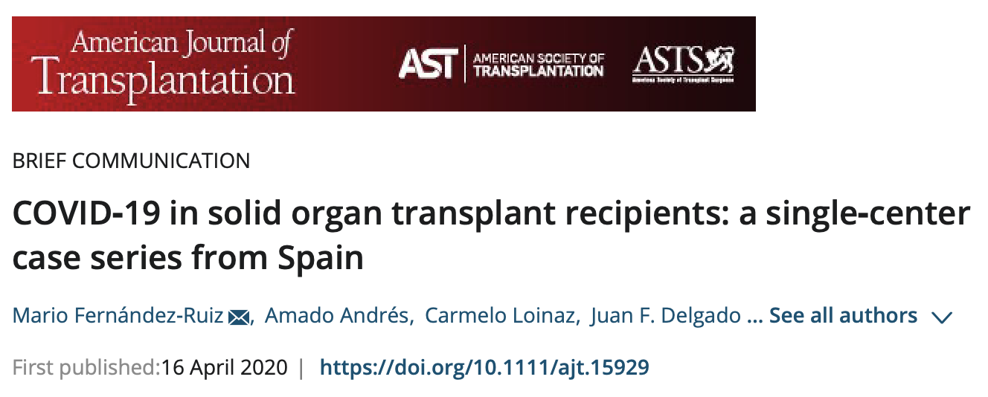
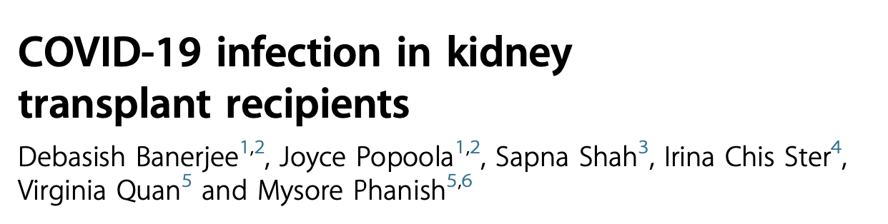
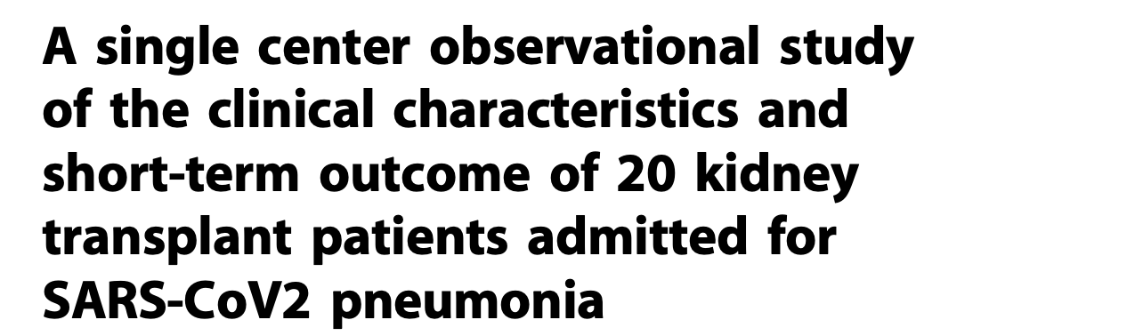
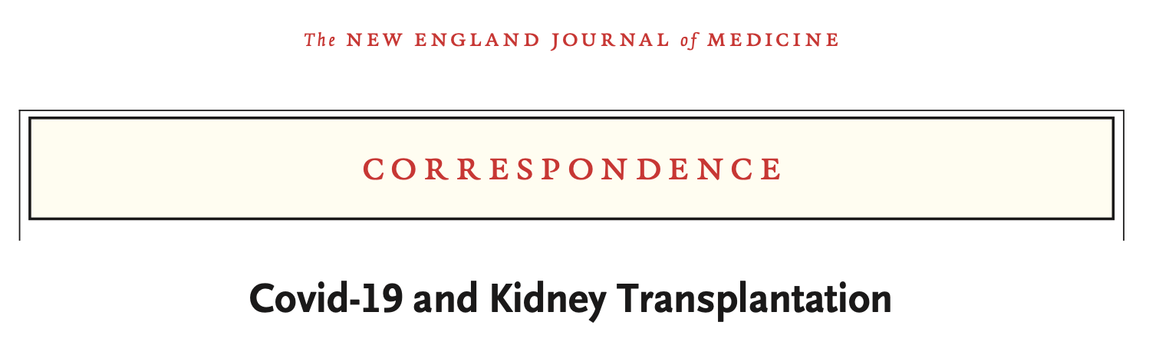


Slide 18
The mortality rate was between 14% to 40% (ours: 45%)
15 -40% of patients developed AKI.(ours: 73.3%)

Slide 19
With regard to prognostic blood tests including lymphocyte counts and serum levels of D dimer, ferritin and troponin are likely to be valuable. (Kidney International (2020); https://doi.org/10.1016/j.kint.2020.03.018)

Slide 20
Diabetes, history of recent rejection
Higher N/L ratio, lower platelet count, elevated N/L x CRP product, higher levels of LDH, positive D-dimer (>0.5 μg/ml), higher troponin, and prolonged PT, on admission predicts worse outcome.

